Slide 1


PSB Hackathon Series-2026
Suraksha Manthan

Slide 2
About the PSB Hackathon
A Hackathon is a collaborative-innovation event where participants ideate, design, and develop technology-driven solutions to real-world challenges within a defined timeframe.
PSB Hackathon Series is an Initiative by Department of Financial Services (DFS), GOI and Indian Bank Association (IBA) for all the 12 Public Sector Banks.
This marks the 2nd iteration of the PSB Hackathon.
PSB Hackathon 2025 was conducted with IK Gujaral Punjab Technical University (IKGPTU)
Leading Product of PSB Hackathon 2025: RupeeBee – A Financial and Cyber-Security Awareness Application empowering citizens with safe digital banking practices.

Slide 3

Why to participate in PSB Hackathon 2026?
Hackathon is a great opportunity for students to learn and grow.
Career Benefits:
Opportunity to showcase prototype at the Global Fintech Fest 2026 (GFF-2026)
Students can showcase their work as highlight in their resume
Work on real-world problems from the banking industry
Apply AI, cyber-security, APIs, and modern technologies
Exciting Rewards:
Prizes worth up to ₹12 Lakhs (Total prize pool)
Certificate of Merit for top teams
Participation Certificate for all participants
This Hackathon is not just a competition —
It’s a chance to showcase your innovation at a national level.

Slide 4

Problem
Banks today face a dual responsibility:
To help customers perform digital banking transactions safely and efficiently
To protect customers from the menace of Cyber Crime
Examples of risks like:
OTP fraud and unauthorized transactions
Fraudulent or risky investment schemes
Impersonation and social engineering attacks
Suspicious beneficiary additions or fund diversions
Hacking or compromise of mobile devices
Installation of malicious or unintended apps
Phishing: Fake emails or messages posing as banks
to steal data
Smishing: Fraudulent SMS with malicious links
Vishing: Calls from imposters posing as bank officials to extract OTPs or passwords

Slide 5



The Problem
Example of a Recent Fraud Case
A person in Chandigarh received a fake WhatsApp message about a traffic e-challan.
The message contained a malicious app link pretending to be official.
After installing it, fraudsters gained access to the phone.
Soon multiple OTP messages started arriving, and the attackers used them to make purchases.
The victim lost more than ₹5.5 lakh from credit cards before the fraud was detected. ￼
Lesson
Even normal actions like clicking a link or sharing OTP can lead to large financial losses.
Banks are in need of smart systems that can detect fraudulent actions before money is lost.

Slide 6

What can be ‘The Solution’
Think of it as a Secure Financial Buddy of a User.
The application should:
Track spending habits, savings & investments
Suggest personalized financial improvements and budgeting tips
Detect suspicious or risky financial actions in real-time
Advanced Protection Features like:
Device Check: Detect logins from new or unrecognized devices
SIM Binding: Link the user’s account to a verified SIM card to prevent misuse from cloned or swapped SIMs
IMEI Integration (or Device Fingerprinting or UUID): Identify the user’s registered device through IMEI or alternative secure device identifiers
Behavior Check: Compare ongoing transactions with past user behavior to flag anomalies
OTP Misuse Detection: Identify multiple OTP requests or unusual activity patterns
Cooling Period: Introduce a short delay for high-risk transactions to allow user verification and prevent fraud
Objective: To proactively alert, guide, and safeguard users—ensuring secure, informed digital financial actions.

Slide 7
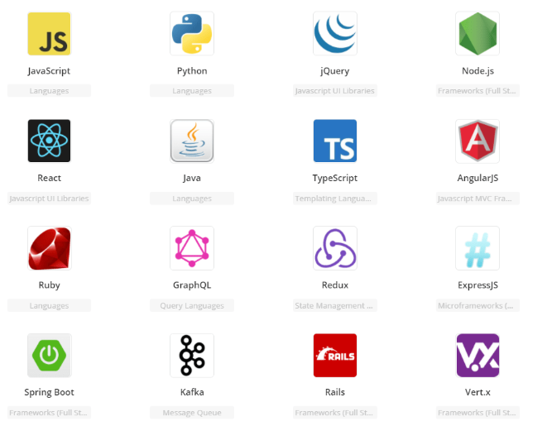
Suggested 3-tier System Architecture & Tech Stack
Suggested Open-source tech stacks, but not limited to these.
Frontend
Web App: React, Angular, or Vue.js
Mobile App: Flutter or React Native
UI Tools: Bootstrap or Tailwind CSS for quick, responsive design
Backend
Frameworks: Spring Boot, Node.js (Express), or Python FastAPI
Use RESTful APIs and open-source logging tools like Log4j, Logback, and monitoring tools like Prometheus, Grafana.
Database
Relational: MySQL, MariaDB, or PostgreSQL
NoSQL: MongoDB
Can use Redis for caching
Deployment
Docker for consistent deployment

Slide 8
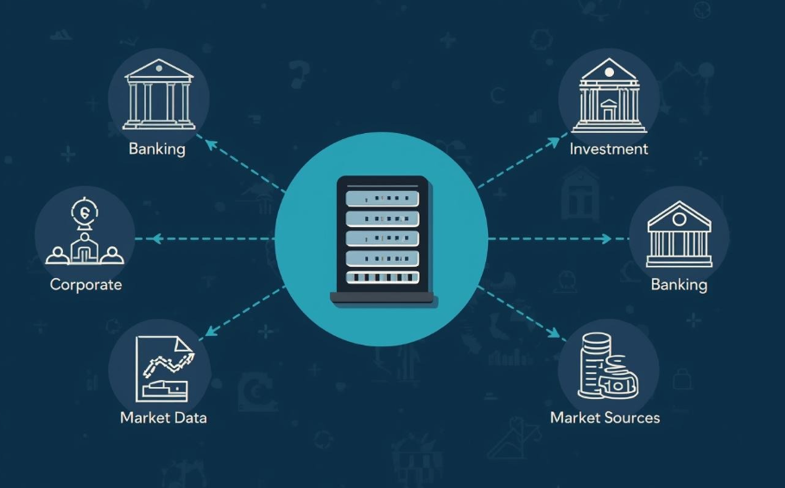
Mock APIs
In real financial systems, services are communicated through API’s:
Retail & Corporate Banking Systems
Investment Platforms
Market Data (NSE/BSE)
News feeds
You can not access bank APIs, so you should create dummy APIs. Example tools:
Postman mock server
JSON Server.
Mockoon
Spring Boot mock endpoints
Free Market / News APIs
Free APIs to simulate real-world intelligence.
Example: GET https://newsapi.org/v2/everything?q=stock-market

Slide 9

Mock Banking System data
You can create dummy data.
Customer Data:
customer_id | name | mobile | email | dob | pan_number
Account:
account_id | customer_id | account_type | balance | branch_code | account_status | last_updated
Transaction Data:
txn_id | account_id | date | amount | txn_type
Investment Data:
investment_id |customer_id |type | instrument_name |units| current_price | purchase_price | date
ITR:
itr_id | customer_id | financial_year | declared_income | tax_paid | deductions | refund_amount
Market Data:
symbol | company_name | sector | current_price | day_high | day_low

Slide 10
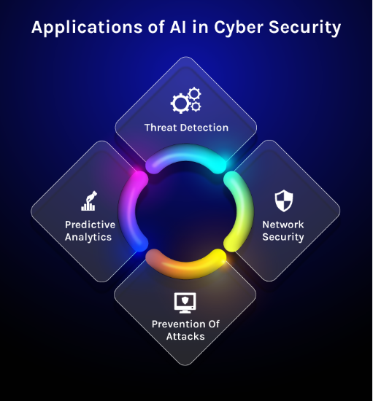
Usage of AI Tools
AI tools like:
Use open and accessible AI APIs for integration and experimentation
Popular platforms include OpenAI, Hugging Face, Google Gemini API, and Sarvam AI
Combine pre-trained models with your own data for contextual insights
AI Use Cases like:
Spending analysis: Categorize and visualize
customer transactions for insights
Fraud pattern detection: Identify anomalies or suspicious
activities using AI models
Cyber threat detection: Monitor network and transaction patterns to identify potential intrusions or malware activity
Phishing and scam detection: Use NLP models to flag suspicious emails, messages, or links targeting customers
Focus on clarity, explain-ability, and measurable outcomes when showcasing AI-driven features.

Slide 11

Security Tips
Core Security Features like:
Data Encryption: Encrypt sensitive data at rest and in transit using secure algorithms (e.g., AES, TLS).
Secure APIs: Implement authentication, authorization, and input validation for all API endpoints.
Geolocation mismatch between device and registered region
OTP Trust + SIM–Device (IMEI) Binding: OTP is accepted only if -
OTP is correct
SIM matches the registered SIM
IMEI matches the registered device
Prevents OTP misuse from cloned SIMs or unauthorized devices
Device Risk Monitoring: A background service runs on the mobile OS to continuously monitor -
Rooting or jailbreak attempts
Malware presence or screen-sharing activity
Accessibility service abuse
Network anomalies or proxy usage

Slide 12
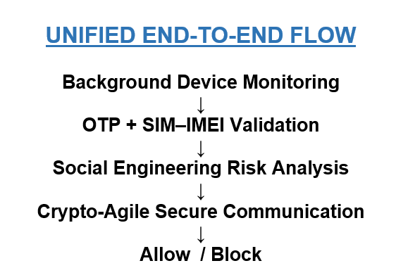
Security Tips (continued)
Social Engineering & Coercion Detection: Detects manipulation or coercion attempts by analyzing-
Active voice call during a transaction
Unusual speed, retries, or urgency in user actions
Frequent app switching or copy-paste behavior
System can trigger alerts, delay transactions, or prompt additional verification
Optional: Crypto‑Agile Communication Framework
Focuses on future‑ready, adaptable security architecture
Introduces a Crypto‑Agility Layer between communicating components
Allows configuration‑based switching between classical and post‑quantum cryptography
Applies to all communication channels, e.g.
Mobile app ↔ Backend
Backend ↔ Backend services
Encourages design for choice and migration, not replacement

Slide 13
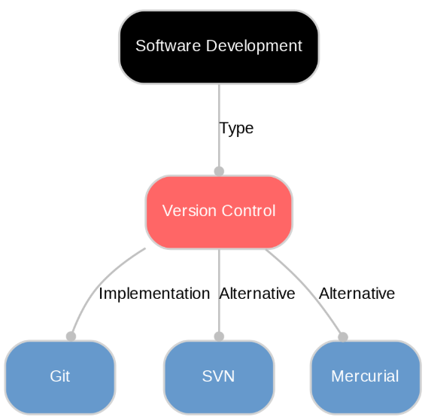
Use a Free Code Repository (GitHub/GitLab)
Create a code repository and store the project code there.
Examples of platforms:
GitHub – most widely used platform for hosting code repositories.
GitLab – similar to GitHub.
Bitbucket – repository platform.
Benefits of Using a Repository
Version Control – track all code changes easily
Team Collaboration – multiple team members can work together
Backup of Code – code remains safe online
Portfolio for Resume – recruiters can see your project

Slide 14

Tips for Students
Important tips :
Keep solution simple
Focus on clear architecture
Build working demo
Show AI + Security features
Explain how it can be adopted & scaled in Banking
Judges always prefer:
Unique & Innovative ideas
Clean UI
Clear explanation

Slide 15
THANK YOU!
For queries, you can reach out to us at - hackathon@psb.bank.in

